Slide 1

泰豐輪胎
Federal co.
泰豐輪胎股份有限公司
114 年度法人說明會
FEDERAL CORPORATION institutional investor conference
114.11.21
1

Slide 2

免責聲明 Safe Harbor Notice
本簡報是建立於本公司從各項來源所取得之資訊。有些 資訊可能受未來不確定性因素影響，致使與原先本公司 對於未來前景的說明迥異。未來若有變更或調整時，請 以公開資訊觀測站公告資訊為依據。
This presentation is based on the information obtained from various sources which the Company believes to be reliable. But at some point in the future, there are a variety of factors which could cause actual results to differ materially from those statements. Therefore, please refer to the information on MOPS website as the main basis if any adjustment has been made.
泰豐輪胎
Federal co.
2

Slide 3
綱要 Table of contents
泰豐輪胎
Federal co.
公司簡介 Company Introduction
營運報告 Operating Report
未來展望 Future Prospects
Q&A
3

Slide 4
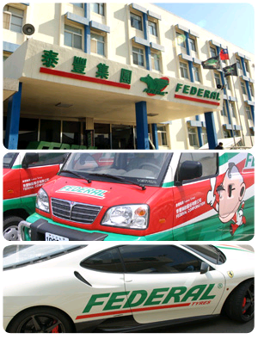
1.公司簡介(Company Introduction)
創立日期：1955年11月
Foundation：Nov., 1955
上市日期：1979年7月
IPO：Jul., 1979
營運總部：台灣桃園
Headquarter：Taoyuan , Taiwan
生產基地：觀音廠 (已停產出售)
Production Plants：Guanyin Plant
資本額：新台幣47.33億元
Capital：TWD 4.733 billion
董事長： 郭林諒
Chairman：Kuo Lin-Liang
員工數：49人 (含江西)
Number of Employees：49 (Global)
主要產品：輻射層汽車外胎、競速用胎等
Main Products：PCR、Motorsports etc.
營業比率：外銷65%、內銷35%
Business ratios：Foreign Sales 65% 、Domestic Sales 35%
4

Slide 5
2.營運報告
Operating Report
5

Slide 6
合併綜合損益表Consolidated Statements of Comprehensive Income
Unit:NT$thousand
項目 | 2025Q1 | 2025Q2 | 2025Q3 | 2025Q3累計 | 2024Q3累計 | YoY
營業收入 net revenues | 75,855 | 61,941 | 62,333 | 200,129 | 196,242 | 3,887
營業毛利 gross profit | 15,651 | 5,988 | 19,393 | 41,032 | 20,871 | 20,161
營業費用 operating expenses | (55,454) | (52,333) | (48,846) | (156,633) | (183,087) | 26,454
營業(損)益 operating profit | (39,803) | (46,345) | (29,453) | (115,601) | (162,216) | 46,615
業外收支合計 non-operating income & expenses | (51,619) | (952,710) | 89,629 | (914,700) | (96,255) | (818,445)
本期稅前(損)益 income before tax | (91,422) | (999,055) | 60,176 | (1,030,301) | (258,471) | (771,830)
所得稅(費用) income tax | 7,435 | (7,096) | 11,324 | 11,663 | (25,598) | 37,261
本期稅後(損)益 net income after tax | (83,987) | (1,006,151) | 71,500 | (1,018,638) | (284,069) | (734,569)
EPS | (0.18) | (2.19) | 0.16 | (2.22) | (0.62) | (1.60)
6

Slide 7
合併資產負債表(Consolidated Balance Sheet )
Unit:NT$thousand
項目 | 2025Q1 | 2025Q2 | 2025Q3 | 2024Q3 | YoY
流動資產 Current Asset | 972,927 | 1,040,818 | 3,805,444 | 1,145,563 | 2,659,881
非流動資產 Non current Asset | 12,459,569 | 11,537,974 | 8,796,820 | 12,443,322 | -3,646,502
總資產合計 Total ssets | 13,432,496 | 12,578,792 | 12,602,264 | 13,588,885 | -986,621
流動負債 Current Liabilities | 1,053,433 | 1,177,226 | 1,199,133 | 890,752 | 308,381
非流動負債 Non Current Liabilities | 5,686,676 | 5,784,236 | 5,689,301 | 5,768,913 | -79,612
總負債合計Total Liabilities | 6,740,109 | 6,961,462 | 6,888,434 | 6,659,665 | 228,769
股東權益Stocksholders' Equity | 6,692,387 | 5,617,330 | 5,713,830 | 6,929,220 | -1,215,390
每股淨值(BVPS) | 14.56 | 12.22 | 12.43 | 15.08 | -2.65
7

Slide 8
3. 未來展望Future Prospects
營運持續：Continued Operations
積極拓展其他市場。.
Actively expanding into other markets
海外代工。 Overseas OEM manufacturing.
越南代工廠:主要生產4X4(四輪傳動休旅車胎)供銷北美區域。
Vietnam OEM plant: Primarily producing 4x4 (four-wheel drive SUV tires) for the North American region.
南港新豐廠代工:主要供應PCR(轎車胎)，供全球北美以外市場。
Nangang Xinfeng OEM plant: Primarily supplying PCR (car tires) to markets outside North America.
泰國廠代工:增加PCR (轎車胎)供美國及其他市場。
Thailand OEM plant: Increasing PCR (car tire) supply to the US and other markets.
考量未來產品多元化發展、時效性及保障輪胎貨源長期穩定供應，亦增加大陸及東南亞其他代工廠合作並行因應
Considering future product diversification, timeliness, and ensuring a stable long-term tire supply, we are also increasing cooperation with other
OEM plants in mainland China and Southeast Asia.
持續接觸未來合作廠家，以穩定供貨、降低貿易障礙、品質優良且價格具競爭力之廠家為合作對象。
We will continue to contact potential future partners, focusing on those with stable supply, low trade barriers, excellent quality, and competitive prices.
逐步產業轉型:
Gradual Industrial Transformation
8

Slide 9
資產活化：Asset Activation
1.工商綜合區土地 Industrial and Commercial Comprehensive Zone Land
已解除土地移轉限制
The land transfer restrictions have been lifted.
積極洽詢有意願開發的廠商
Proactively engaging with potential developers expressing interest in development.
2.自辦重劃住宅土地 Residential Land of Rezoning District:
核准日:111年11月17日桃園市政府公告核准本公司中壢區泰豐自辦市地重劃區重劃會實施市地重劃，重劃期限原則為3年，必要時得延長2年。
Approval Date: The Taoyuan City Government announced its approval for the Urban Rezoning Committee of FEDERAL
CORPORATION in Zhongli District to implement urban rezoning on November 17, 2022.The rezoning period is generally 3 years,
which can be extended by 2 years if necessary.
公司於114年7月25日已獲准申請再展延2年至116年8月29日完成重劃。
On July 25, 2025, the company was granted a further 2-year extension to complete the rezoning by August 29, 2027.
目前重劃進度均依計畫執行，公共工程預計115年9月完成，重劃預計116年8月完成。.
Currently, the rezoning progress is proceeding according to plan. Public works are expected to be completed in September 2026, and
the rezoning is expected to be completed in August 2027.
3.觀音廠房及土地：Guanyin Plant and Land
114年7月1日已經股東會決議通過以不低於新台幣68億元出售處分。
On July 1, 2025, the Shareholders' Meeting resolved to sell the land for no less than NT$6.8 billion.
最終以新台幣69.5億元售予台達電子(股)公司。
It was ultimately sold to DELTA ELECTRONICS INC. for NT$6.95 billion.
目前各期售地款依計劃入信託戶，公司爭取於12月底前完成過戶入帳。
The proceeds from the land sale are currently being deposited into the trust account as planned, and the Company aims to complete the transfer and enter into account by the end of December.
9

Slide 10
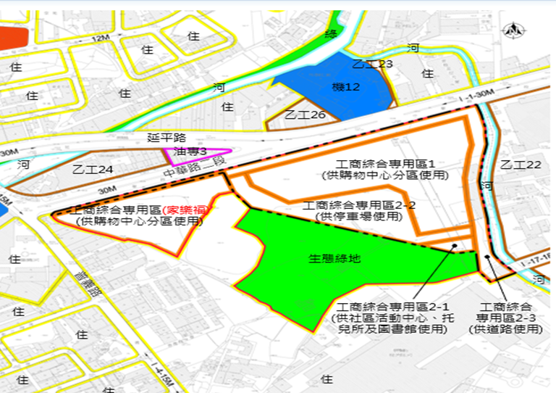
泰豐工商綜合區說明
10

Slide 11
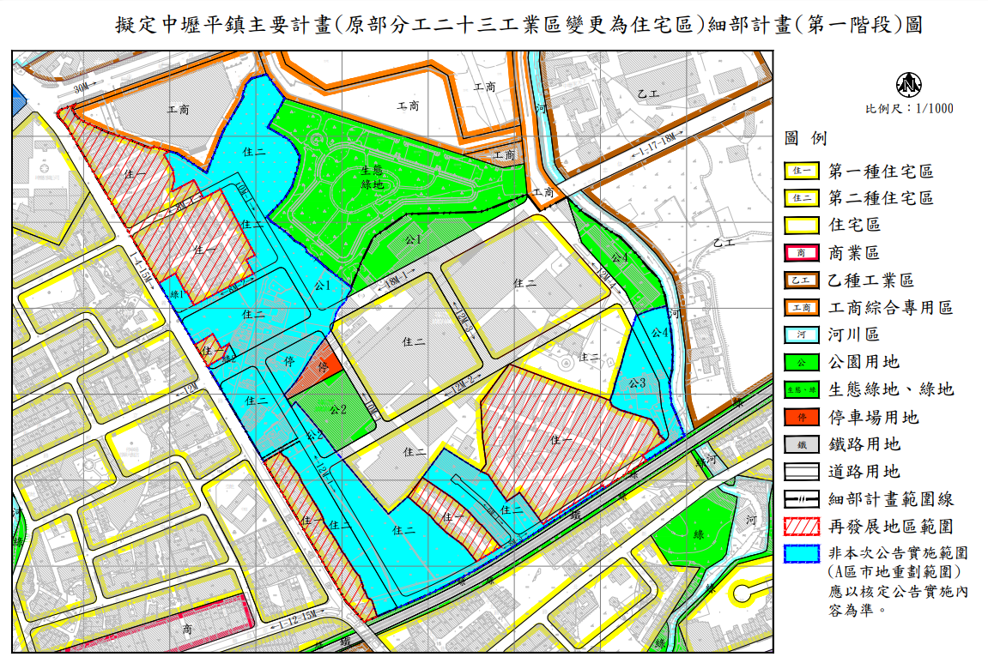
桃園市中壢區泰豐自辦市地重劃說明
11

Slide 12
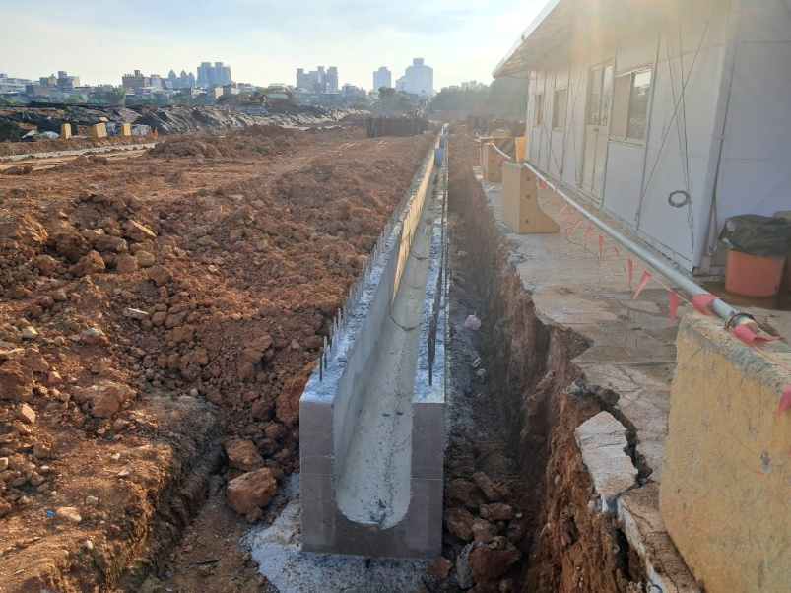
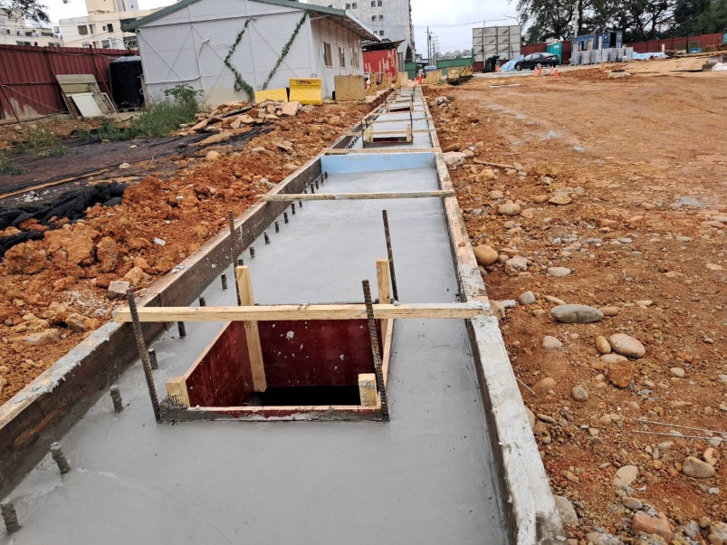
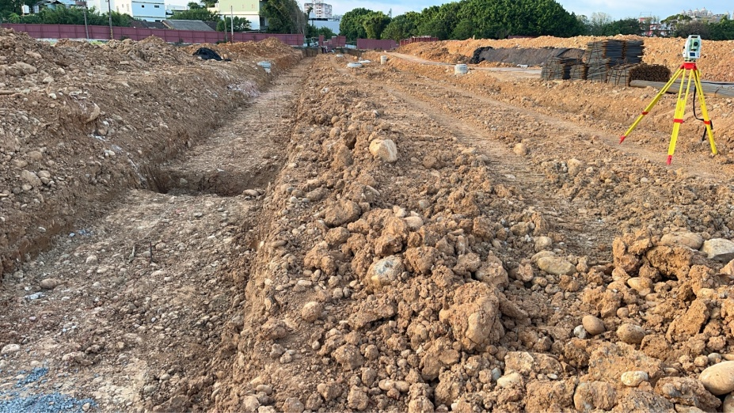
原中壢廠( Former Zhongli Plant)，
現為泰豐自辦市地重劃區(Rezoning District of Federal Corporation)
廠房已拆除，目前重劃依進度進行中
The factory has been demolished and the rezoning is currently in progress
12

Slide 13
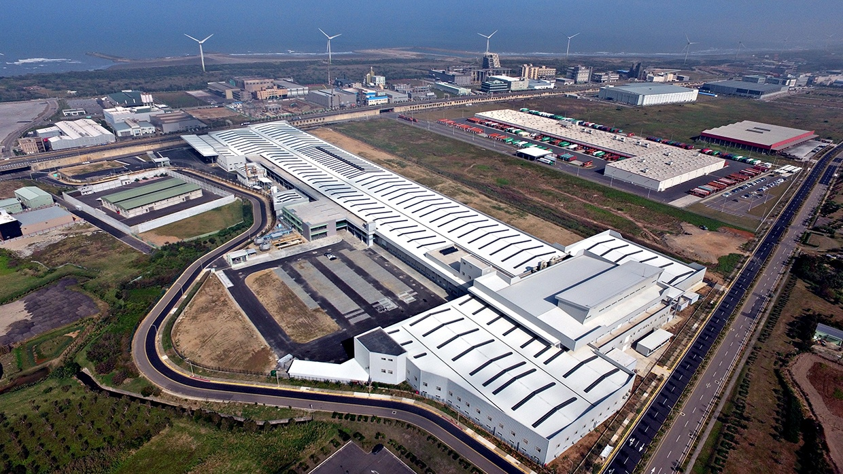
觀音廠(Guanyin Plant)
佔地面積：34,688坪
Land Area：34,688 ping (114,672 square meters)
停產 (由於美國執行反傾銷稅)
Discontinued Production(Due to US implements anti-dumping duties)
13

Slide 14
Q&A
THANK YOU !
14

